Slide 1
Covid-19 Dashboard
Done by: Abdul Haziq, Marni, Amal and Gary

Slide 2
Outline
Purpose of Dashboard
Introduction
Who done the tasks
Dataset Preparation
Marni Task
Haziq Task
Amal Task
Gary Task
Dashboard
Github link

Slide 3
Purpose of Dashboard
Users able to view:
Confirm cases, deaths globally with daily statistics.
Country-specific info by clicking on any country on the map.
Interactive chart showing reported cases by WHO
Help user to see correlations and relationships that can provide insights into COVID-19 and how communities responding to it.

Slide 4
Introduction
The dashboard is supported by the team of four that gather data, make visualization and perform analysis regarding the COVID-19 epidemic.
The Dashboard is program by using JavaScript, HTML, CSS and D3.js
The Dashboard focus on the month of March.
The Dashboard is compile from individual tasks.

Slide 5
Who done the task?
1. Haziq – created the interactive map to show individual country with information of confirm cases, death and recovery statistics.
2. Amal – created the total line graph of total confirmed cases, total deaths and total recovery.
3. Marni – created COVID-19 Radial Scale Chart and Summary Tiles
4. Gary – created table of top 15 countries with confirm cases.

Slide 6
Dataset Preparation
The data was obtained from Kaggle of up-to-date of COVID-19.
The first dataset contain the information from January until April.
The dataset obtained was extracted into three datasets namely Covid-19 dataset (March), covid-19top15 and covid-19 total datasets.
The Covid-19 March dataset narrow the information of single month.
The Covid-19top15 dataset contains the top 15 countries with most confirm cases of Covid-19.
Lastly, Covid-19 total contains the information of end of March.
World-110m.json was added as well.

Slide 7
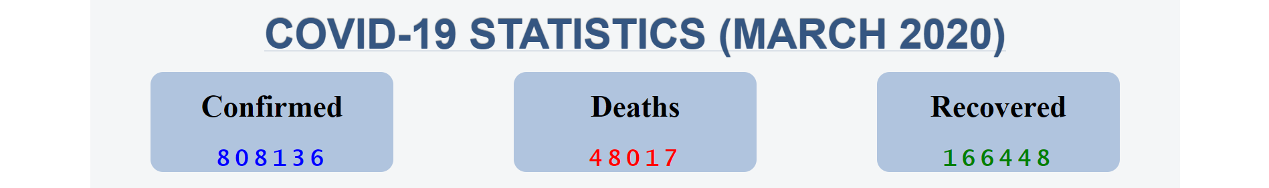
Marni Tasks
to compile all the total statistics of confirmed, death and recovered cases in Summary Tiles.
A summary tile can be a powerful way to put attention to one, or several important statistics such as number of Confirm case.
This can help to set tone for the rest of the Dashboard.

Slide 8
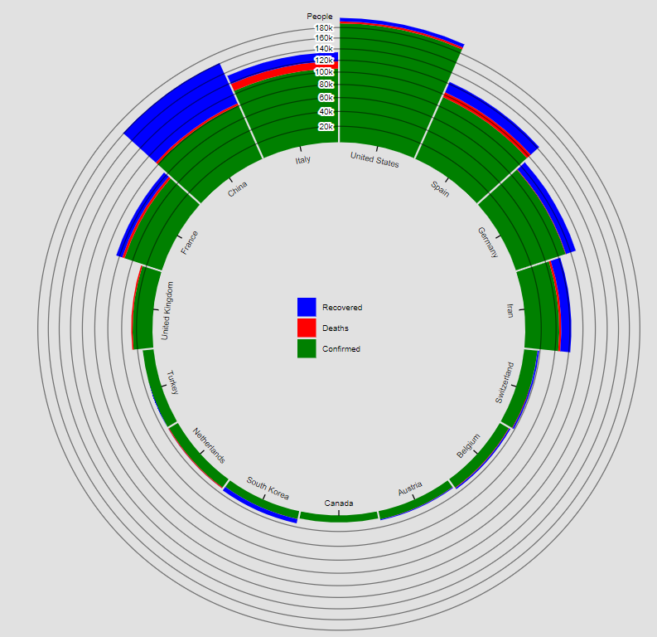
Marni Tasks
Marni’s Task was to created Radial Scale Chart for visualize.
Radial Scale Chart used to emphasize cyclical patterns.

Slide 9
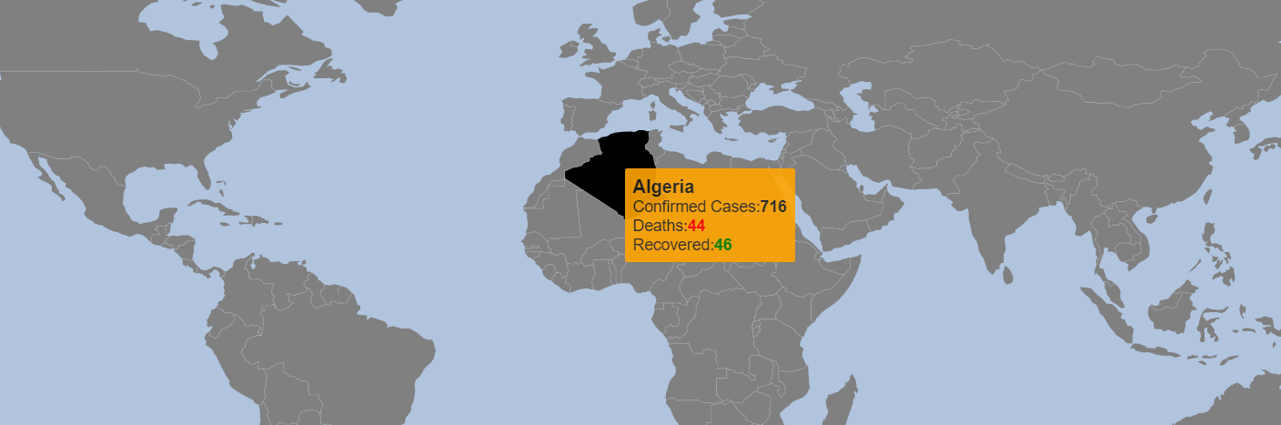
Haziq Task
Haziq’s task was to created interactive map that shows individual country with information by hovering around using tooltip.
Each country contains the name, number of confirmed cases, deaths and recovered.
Zooming capabilities with d3 zoom function.
Utilizing topojson dataset by linking country id with covid-19 dataset to fetch necessary data and features.

Slide 10
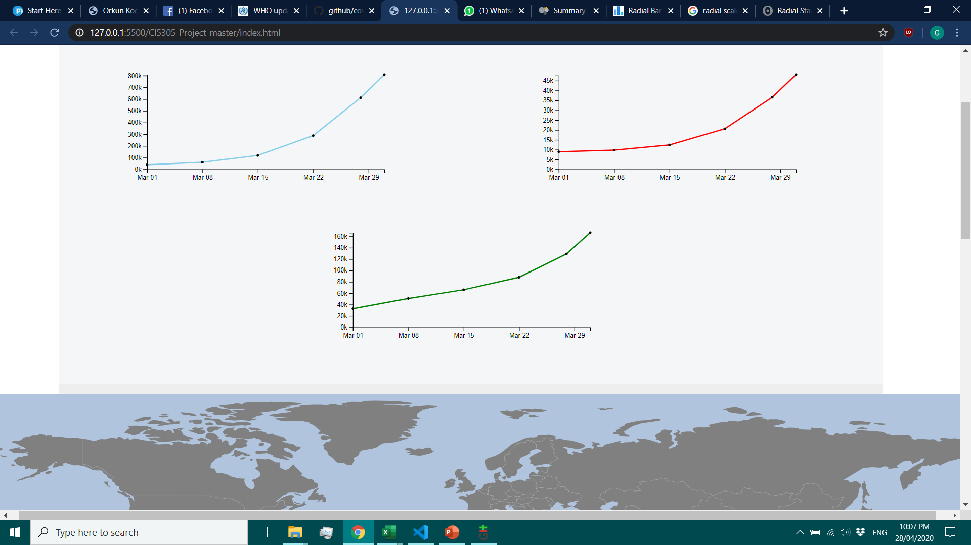
Amal Task
Confirmed Cases
Death Cases
Recovered Cases
Amal’s task was to created three line graphs of March with Confirmed, Death and Recovered cases.
This show the tally of day in the month of March.

Slide 11
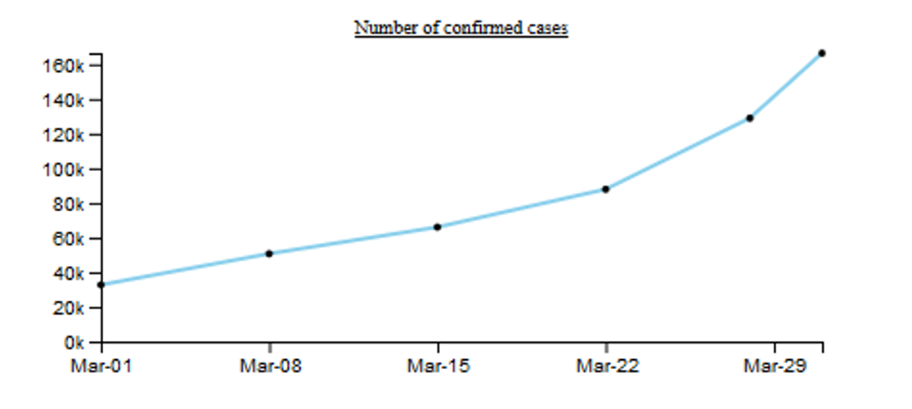

Slide 12
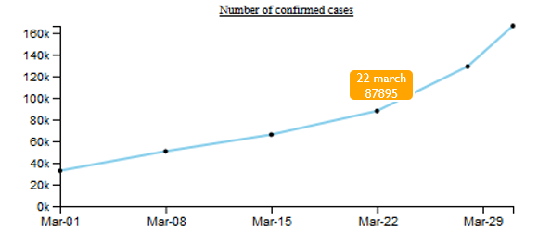

Slide 13
Data Sources
Covid-19 dataset.csv, COVID19 dataset (March 2020).csv and covid-19Totaldataset.
Date
Total confirmed cases
Total death cases
Total recovered cases

Slide 14
Implementation of Line Chart
Import the D3.js library directly from the CDN inside the HTML.
Parse the date / Time
Set the range and define the line axis
Append the SVG element
Get the data and format the data accordingly
Scale the range of data
Add the value line path
Add the X-axis and Y-axis
Additional: Create the dots with tooltips as well as the title of the charts

Slide 15
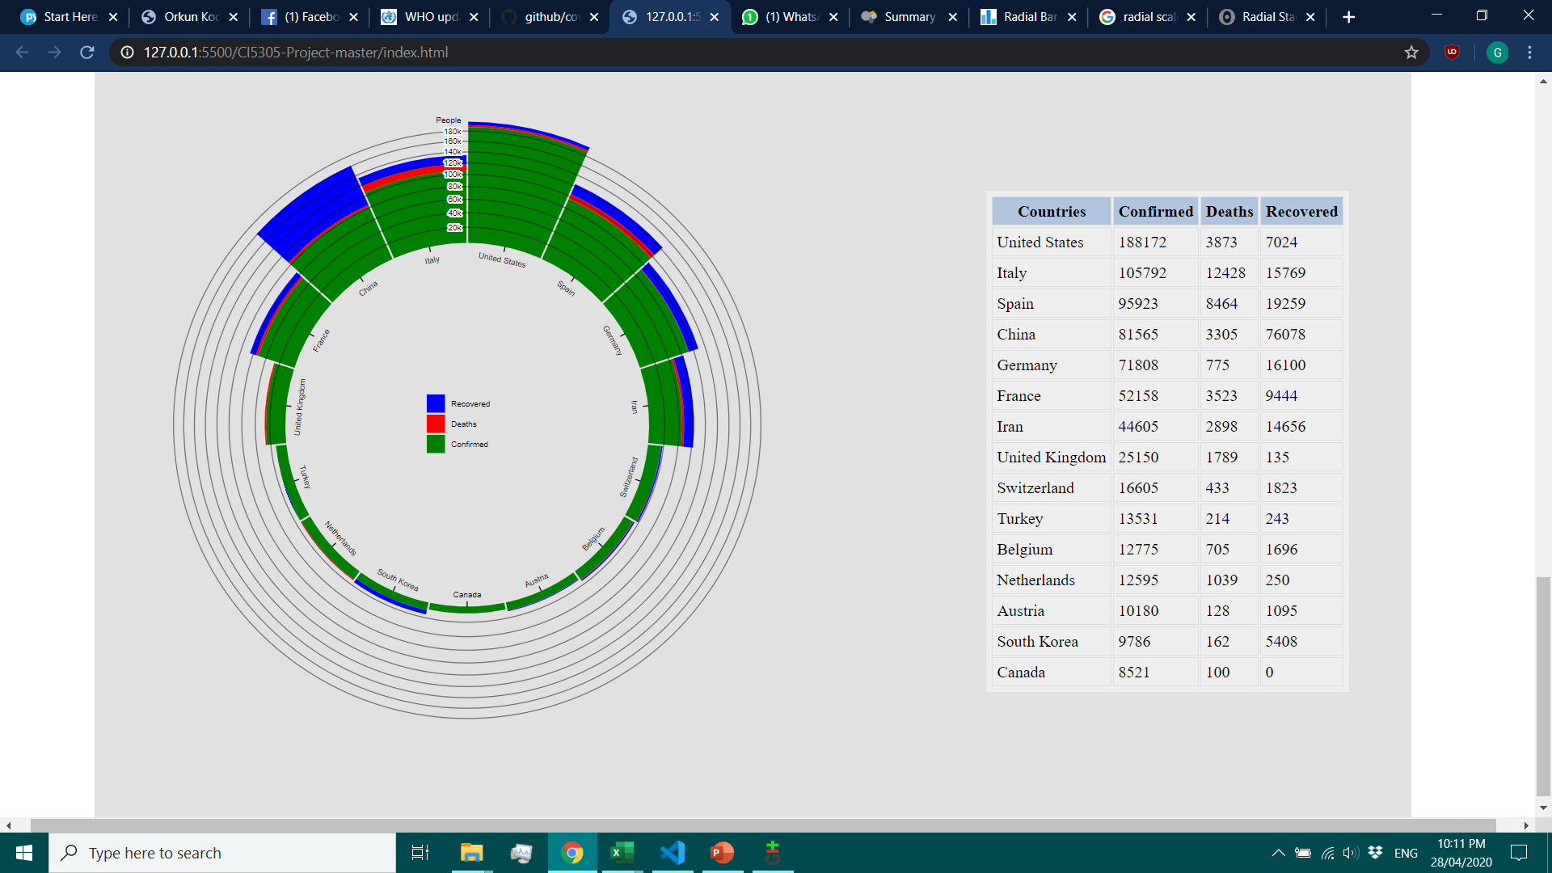
Gary Task
Gary’s task was to created Table chart of top 15 countries of highest confirmed cases in the month of March.
Implementation using D3 and used Covid-top15 dataset to list top 15 countries.

Slide 16
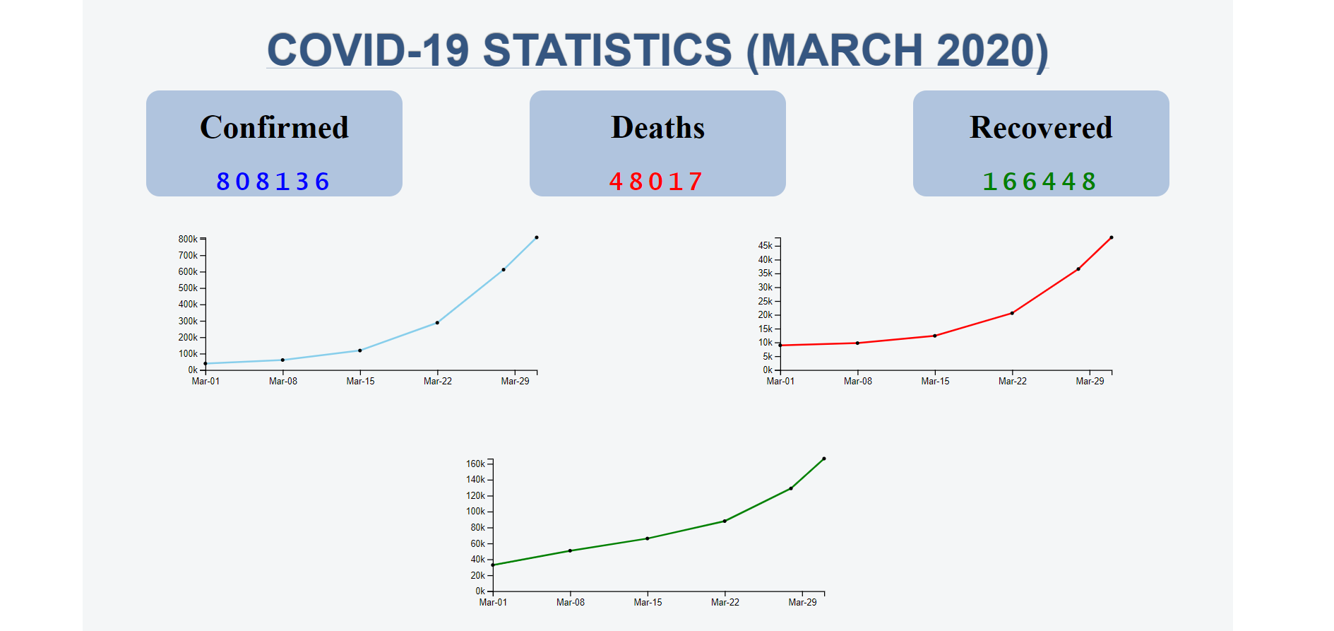
Dashboard

Slide 17
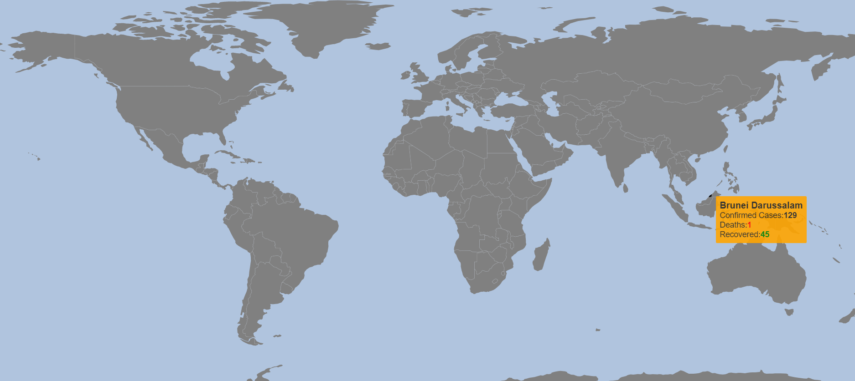
Dashboard

Slide 18
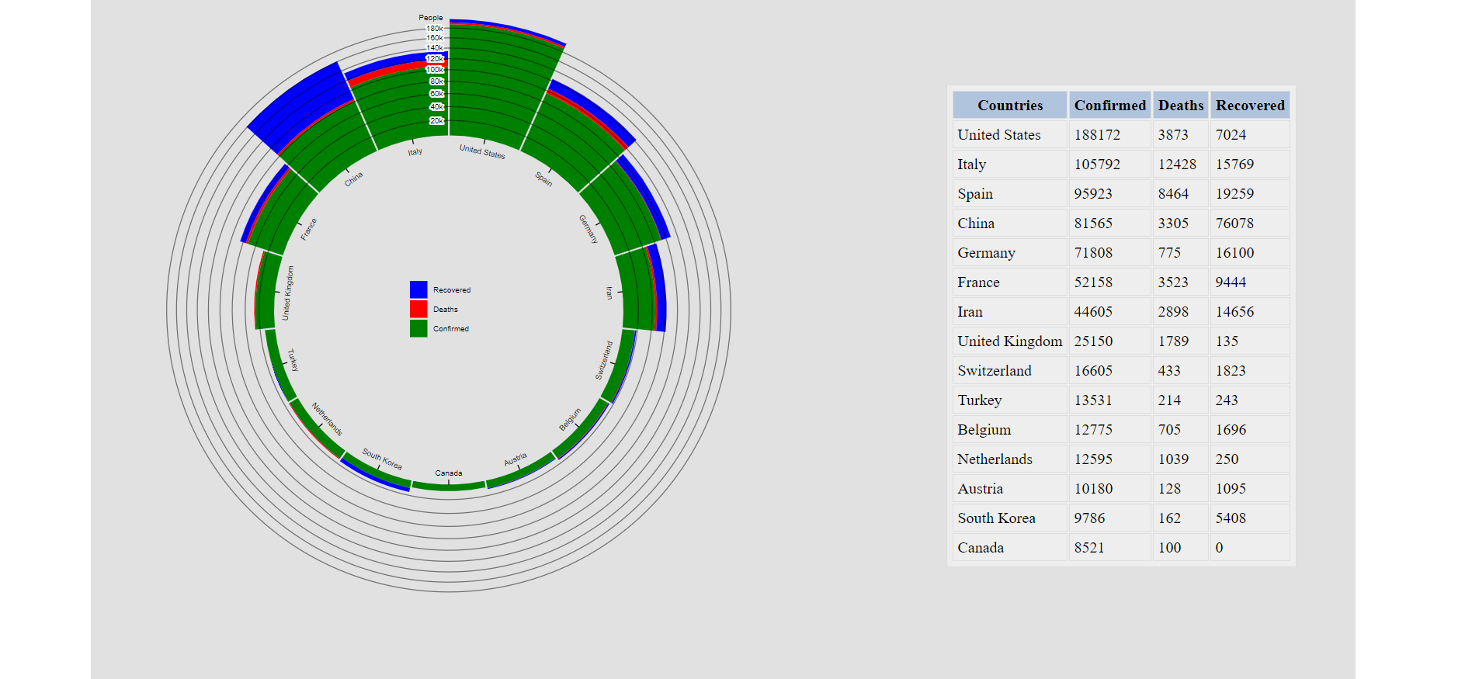
Dashboard

Slide 19
GitHub Link
Link: https://github.com/haziqqbaharin/CI5305-Project

